Slide 1
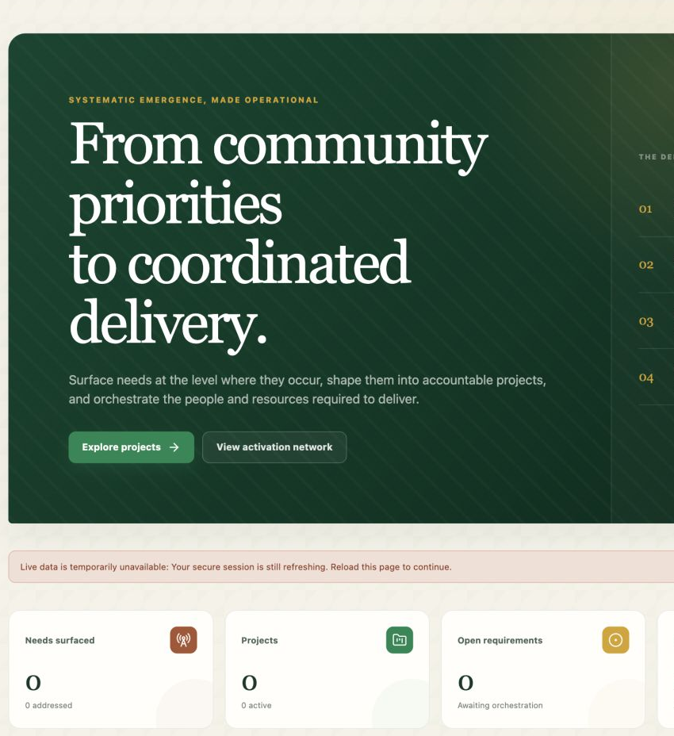
VISUAL PLATFORM SHOWCASE
Community priorities.
Coordinated delivery.
One national operating platform for community activation, credible enterprise and evidence-led market orchestration.
CSR & PHILANTHROPIC PARTNER BRIEFING
Illustrative walkthrough · August 2026
Notes:
Open with the operating challenge: credible local priorities and capable market actors often remain disconnected.
[Sources]
- Community Activation & Market Orchestration Platform, live application capture, 14 Aug 2026.
- "The Programme – Architecture Infographic", internal programme architecture supplied by Euchreston.
- "Executive Summary 1 – Roles and Development Proposition", internal programme documentation supplied by Euchreston.
- "Executive Summary 2 – Organization and Operational Proposition", internal programme documentation supplied by Euchreston.
[/Sources]

Slide 2
WHY THE PLATFORM EXISTS
Good intent is abundant. Connected operating evidence is not.
Needs, local contribution, projects, providers, sponsorship and investment often live in separate records—making coordination hard and trust fragile.
The integration
Make the line from a local signal to an accepted outcome visible—and govern every hand-off in between.
PRIORITY
What matters here?
CAPABILITY
Who can credibly act?
ACCOUNTABILITY
What was agreed and delivered?
The platform is not a project directory. It is an operating mechanism.
COMMUNITY ACTIVATION + MARKET ORCHESTRATION
02
Notes:
Frame fragmentation as an operating problem rather than a lack-of-ideas problem.
[Sources]
- "The Programme – Architecture Infographic", internal programme architecture supplied by Euchreston.
- "Executive Summary 1 – Roles and Development Proposition", internal programme documentation supplied by Euchreston.
- "Executive Summary 2 – Organization and Operational Proposition", internal programme documentation supplied by Euchreston.
[/Sources]

Slide 3
ONE PLATFORM · TWO LEGITIMATE ORIGINS
Community demand and market initiative enter differently—then share the same trust spine.
A priority may originate in a place. A proposition may originate with an entrepreneur. Neither route is forced to pretend it is the other.
COMMUNITY ORIGIN
SHARED OPERATING CORE
MARKET ORIGIN
A priority in a place
Identity · projects
matching · commitments
evidence
A proposition to test
Evidence · affected population · local contribution
Capability · model · capital or support sought
OUTCOME + LEARNING
COMMUNITY ACTIVATION + MARKET ORCHESTRATION
03
Notes:
Explain that the integrated model protects both legitimate origins while sharing identity, trust and fulfilment controls.
[Sources]
- "The Programme – Architecture Infographic", internal programme architecture supplied by Euchreston.
- "Executive Summary 1 – Roles and Development Proposition", internal programme documentation supplied by Euchreston.
- "Executive Summary 2 – Organization and Operational Proposition", internal programme documentation supplied by Euchreston.
[/Sources]

Slide 4
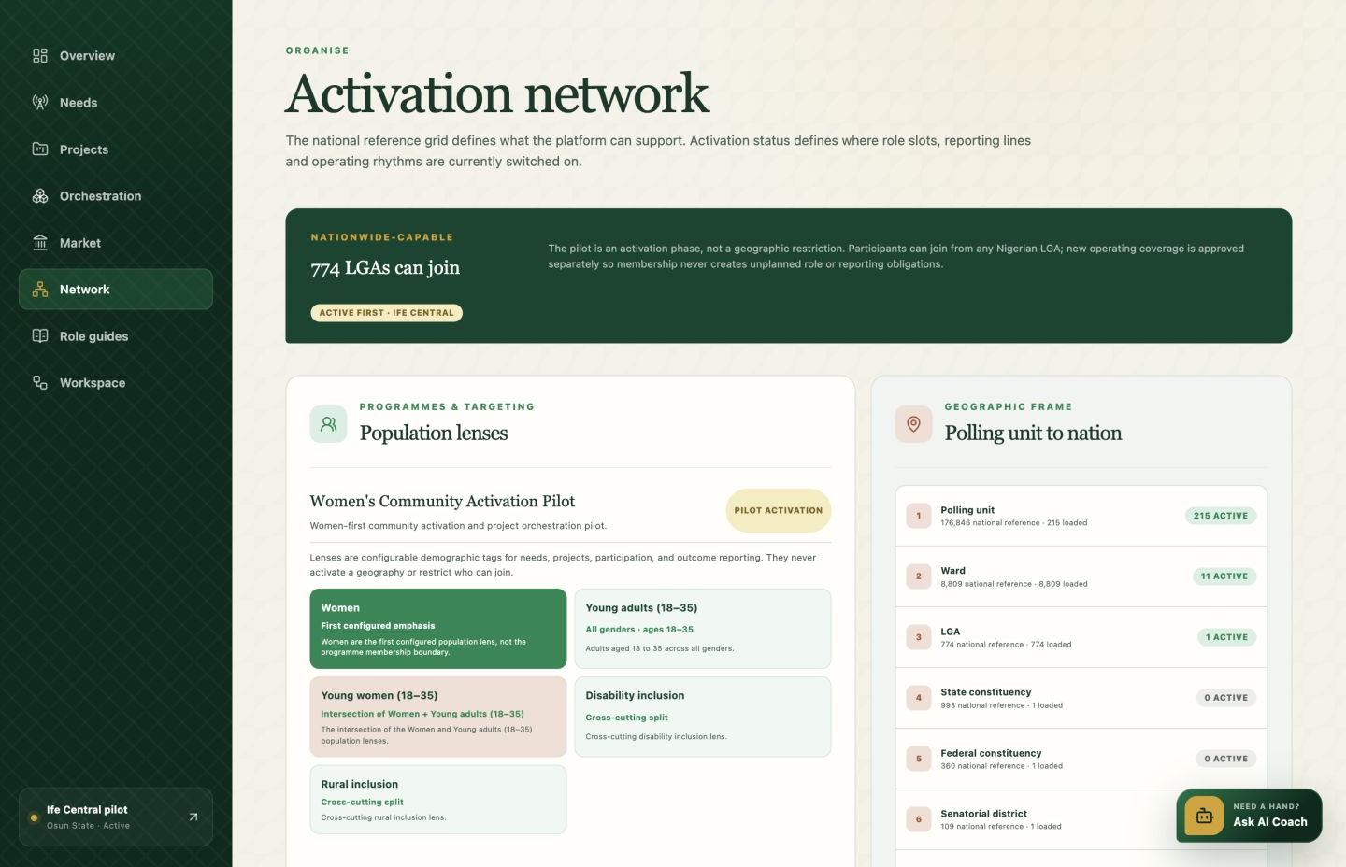
NATIONAL FRAME · LOCAL ACTIVATION
The whole country is possible. Activation is earned place by place.
NATIONWIDE-CAPABLE
Every LGA can join the mechanism.
LOCALLY ACTIVATED
A place becomes active when local roles, safeguards, evidence and an operating rhythm are ready—not merely because it exists in the national hierarchy.
COMMUNITY ACTIVATION + MARKET ORCHESTRATION
04
Notes:
Distinguish nationwide technical availability from active programme readiness.
[Sources]
- Community Activation & Market Orchestration Platform, live application capture, 14 Aug 2026.
- "The Programme – Architecture Infographic", internal programme architecture supplied by Euchreston.
- "Executive Summary 1 – Roles and Development Proposition", internal programme documentation supplied by Euchreston.
- "Executive Summary 2 – Organization and Operational Proposition", internal programme documentation supplied by Euchreston.
[/Sources]

Slide 5
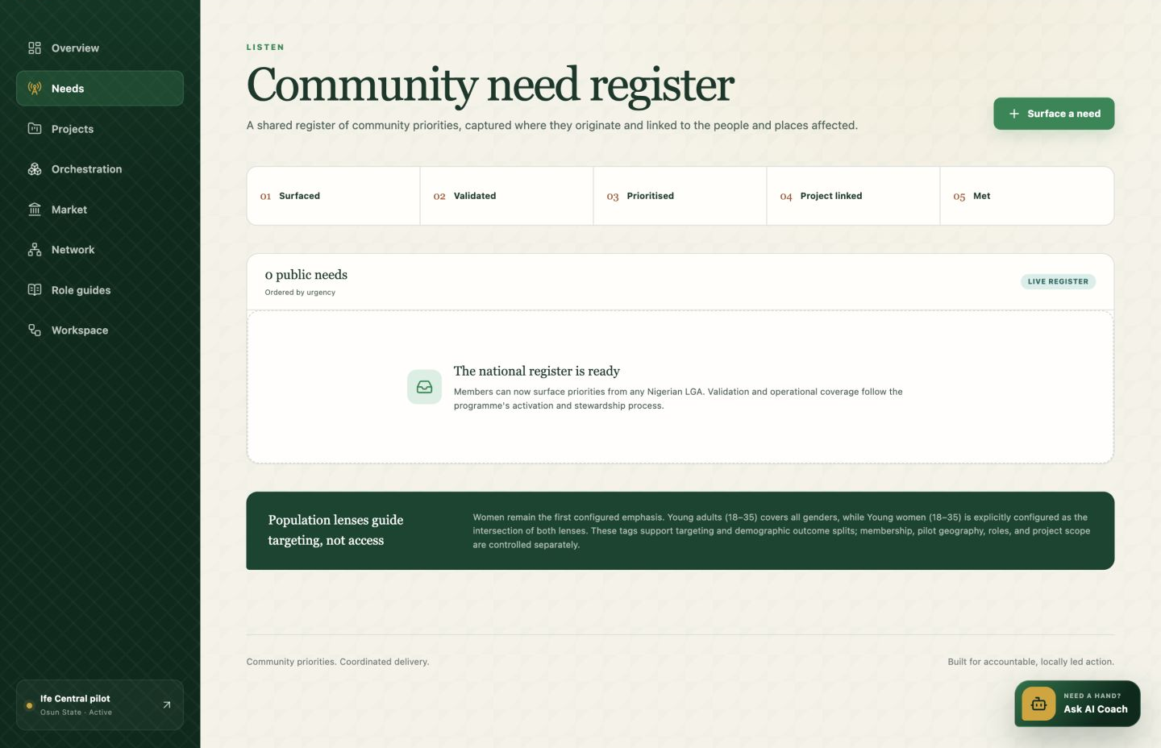
COMMUNITY JOURNEY · LISTEN AND VALIDATE
The record begins with what people observed—not a pre-written solution.
ILLUSTRATIVE RECORD
Young adults need an accessible place for practical digital and enterprise sessions.
•
Origin: ward listening session
•
Evidence: 36 participants · 3 groups
•
Status: validated
•
Local offer: venue + volunteer time
COMMUNITY ACTIVATION + MARKET ORCHESTRATION
05
Notes:
Point out that offline listening can be documented first, preserving provenance and local contribution.
[Sources]
- Community Activation & Market Orchestration Platform, live application capture, 14 Aug 2026.
- "The Programme – Architecture Infographic", internal programme architecture supplied by Euchreston.
- "Executive Summary 1 – Roles and Development Proposition", internal programme documentation supplied by Euchreston.
- "Executive Summary 2 – Organization and Operational Proposition", internal programme documentation supplied by Euchreston.
- Illustrative scenario created for this presentation; no live pilot metrics.
[/Sources]

Slide 6
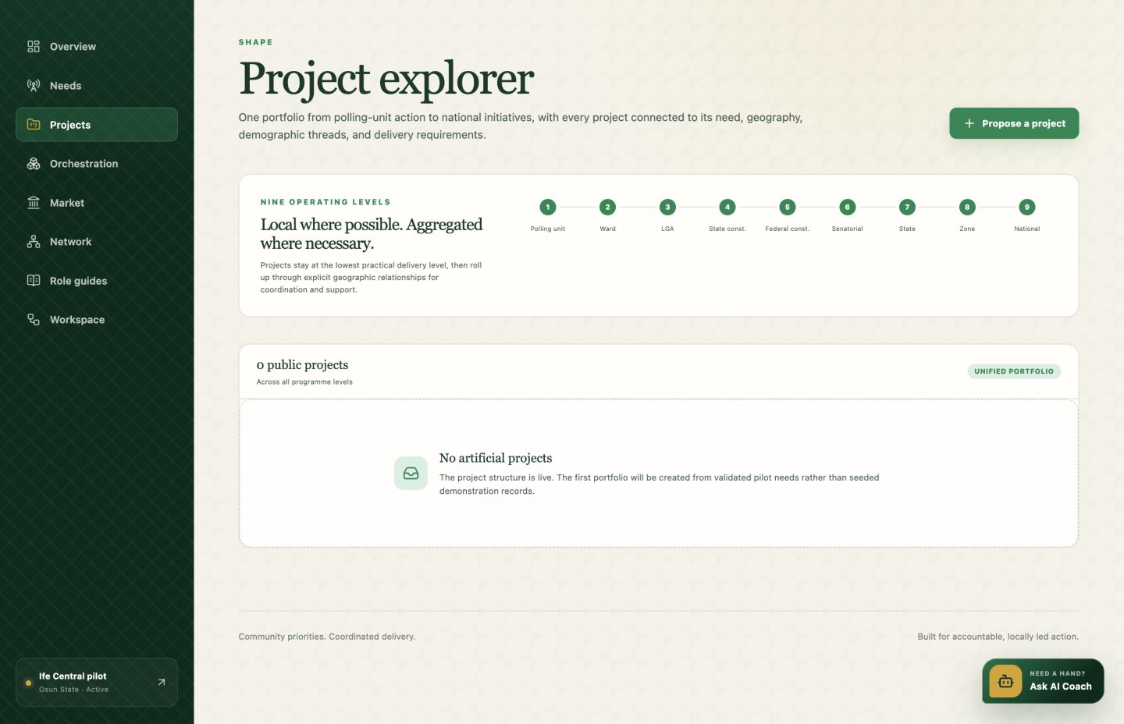
COMMUNITY JOURNEY · SHAPE A PROJECT
Only the validated gap moves forward—and it remains traceable to the need.
Ife Central Community Skills Lab
A governed project proposal with ownership, approvals and a complete delivery hypothesis.
01
Community contribution
Venue · mobilisation · volunteer facilitators
02
Remaining gap
Devices · connectivity · specialist facilitation
03
Decision trace
Need validation · project approval · named accountable lead
COMMUNITY ACTIVATION + MARKET ORCHESTRATION
06
Notes:
Emphasise that the platform documents both local contribution and the external gap.
[Sources]
- Community Activation & Market Orchestration Platform, live application capture, 14 Aug 2026.
- "The Programme – Architecture Infographic", internal programme architecture supplied by Euchreston.
- "Executive Summary 1 – Roles and Development Proposition", internal programme documentation supplied by Euchreston.
- "Executive Summary 2 – Organization and Operational Proposition", internal programme documentation supplied by Euchreston.
- Illustrative scenario created for this presentation; no live pilot metrics.
[/Sources]

Slide 7
MARKET-FACING REQUIREMENTS
A precise requirement invites a credible response—not a vague appeal.
Each requirement states the outcome, quantity, timing, location, acceptance evidence and support type before matching begins.
01
12 refurbished laptops
02
2 specialist facilitators
Equipment · delivery by 15 Oct
Capability · 24 hours over 6 weeks
03
3-month connectivity
04
Independent safeguarding review
Service · minimum 50 Mbps
Assurance · before participant intake
COMMUNITY ACTIVATION + MARKET ORCHESTRATION
07
Notes:
Describe requirements as acceptance-ready market positions, not generic wish lists.
[Sources]
- "The Programme – Architecture Infographic", internal programme architecture supplied by Euchreston.
- "Executive Summary 1 – Roles and Development Proposition", internal programme documentation supplied by Euchreston.
- "Executive Summary 2 – Organization and Operational Proposition", internal programme documentation supplied by Euchreston.
[/Sources]

Slide 8
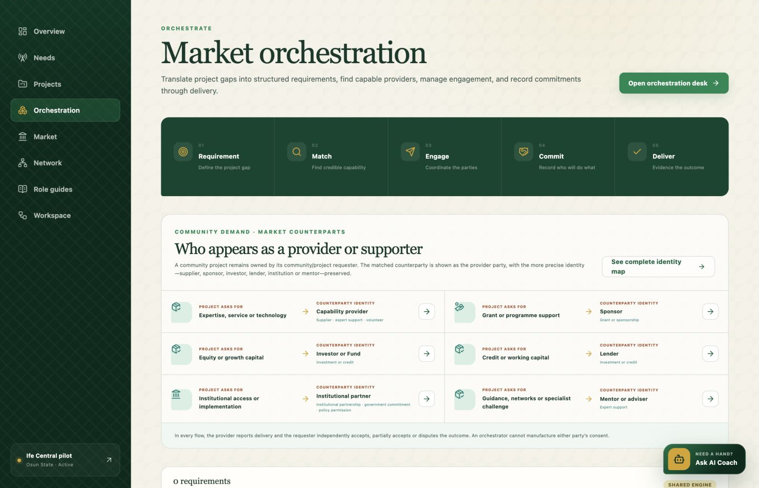
ORCHESTRATION · COMPARE BEFORE COMMITMENT
Matching is a decision process, not a directory search.
ILLUSTRATIVE FIT VIEW
92%
Capability provider
3 relevant deliveries
88%
Institutional partner
Authority confirmed
84%
CSR sponsor
Mandate aligned
Interest is private until both sides choose to proceed; only then does a governed commitment exist.
COMMUNITY ACTIVATION + MARKET ORCHESTRATION
08
Notes:
Explain that fit is evidence-informed and consent-based, not a public leaderboard.
[Sources]
- Community Activation & Market Orchestration Platform, live application capture, 14 Aug 2026.
- "The Programme – Architecture Infographic", internal programme architecture supplied by Euchreston.
- "Executive Summary 1 – Roles and Development Proposition", internal programme documentation supplied by Euchreston.
- "Executive Summary 2 – Organization and Operational Proposition", internal programme documentation supplied by Euchreston.
- Illustrative matching scores created for this presentation; no live pilot metrics.
[/Sources]

Slide 9
TRUST SPINE
Trust is contextual, evidenced and revisable.
NOT
a popularity score
The system records why confidence exists, for which scope, and how the evidence changes after delivery.
01
Identity & authority
Who is acting—and may they commit the represented entity?
02
Provenance
Claim, counterparty confirmation, observation or verified fact?
03
Independent consent
Requester and provider confirm the commitment separately.
04
Fulfilment acceptance
Delivered, partially accepted, disputed or remediated.
05
Contextual record
Reliable for what, based on which evidence and how recently?
COMMUNITY ACTIVATION + MARKET ORCHESTRATION
09
Notes:
Trust is managed as evidence in context, not as a social rating.
[Sources]
- "The Programme – Architecture Infographic", internal programme architecture supplied by Euchreston.
- "Executive Summary 1 – Roles and Development Proposition", internal programme documentation supplied by Euchreston.
- "Executive Summary 2 – Organization and Operational Proposition", internal programme documentation supplied by Euchreston.
[/Sources]

Slide 10
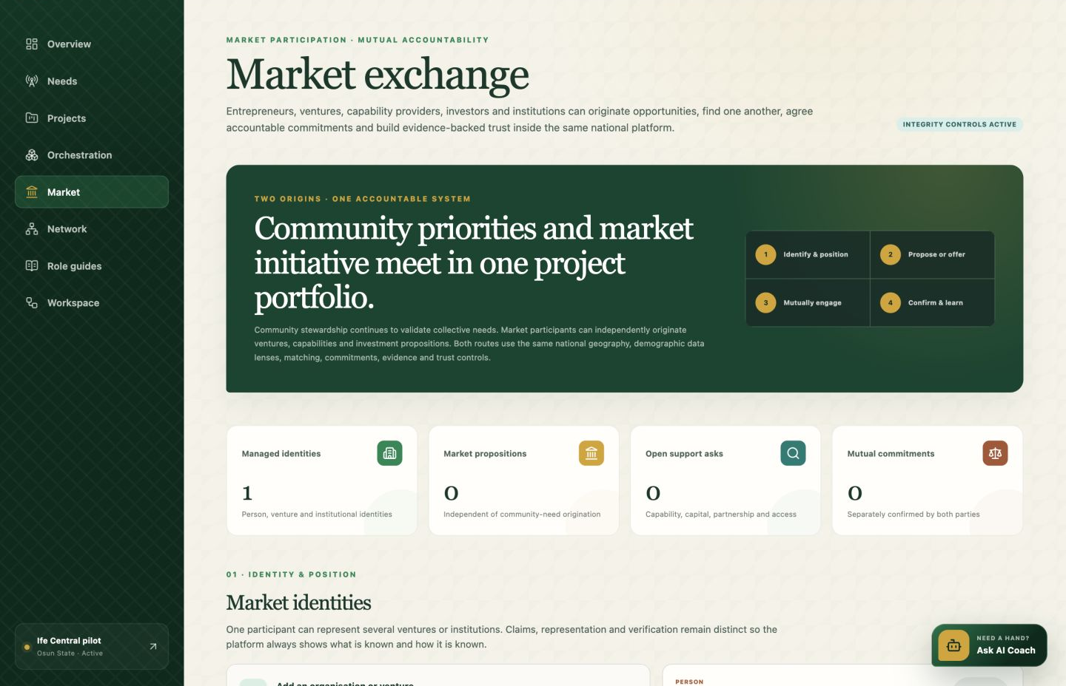
MARKET JOURNEY · ENTREPRENEUR-LED ORIGIN
A credible proposition can seek support without pretending to be a community need.
ILLUSTRATIVE PROPOSITION
Neighbourhood cold-chain service
An entrepreneur submits capability, operating model, evidence and the specific support sought.
1
Screen identity + authority
2
Assess proposition + safeguards
3
Match capital, capability or access
4
Record commitment + performance evidence
COMMUNITY ACTIVATION + MARKET ORCHESTRATION
10
Notes:
Position the market route as a first-class origin with the same integrity controls.
[Sources]
- Community Activation & Market Orchestration Platform, live application capture, 14 Aug 2026.
- "The Programme – Architecture Infographic", internal programme architecture supplied by Euchreston.
- "Executive Summary 1 – Roles and Development Proposition", internal programme documentation supplied by Euchreston.
- "Executive Summary 2 – Organization and Operational Proposition", internal programme documentation supplied by Euchreston.
- Illustrative entrepreneur scenario created for this presentation; no live pilot metrics.
[/Sources]

Slide 11
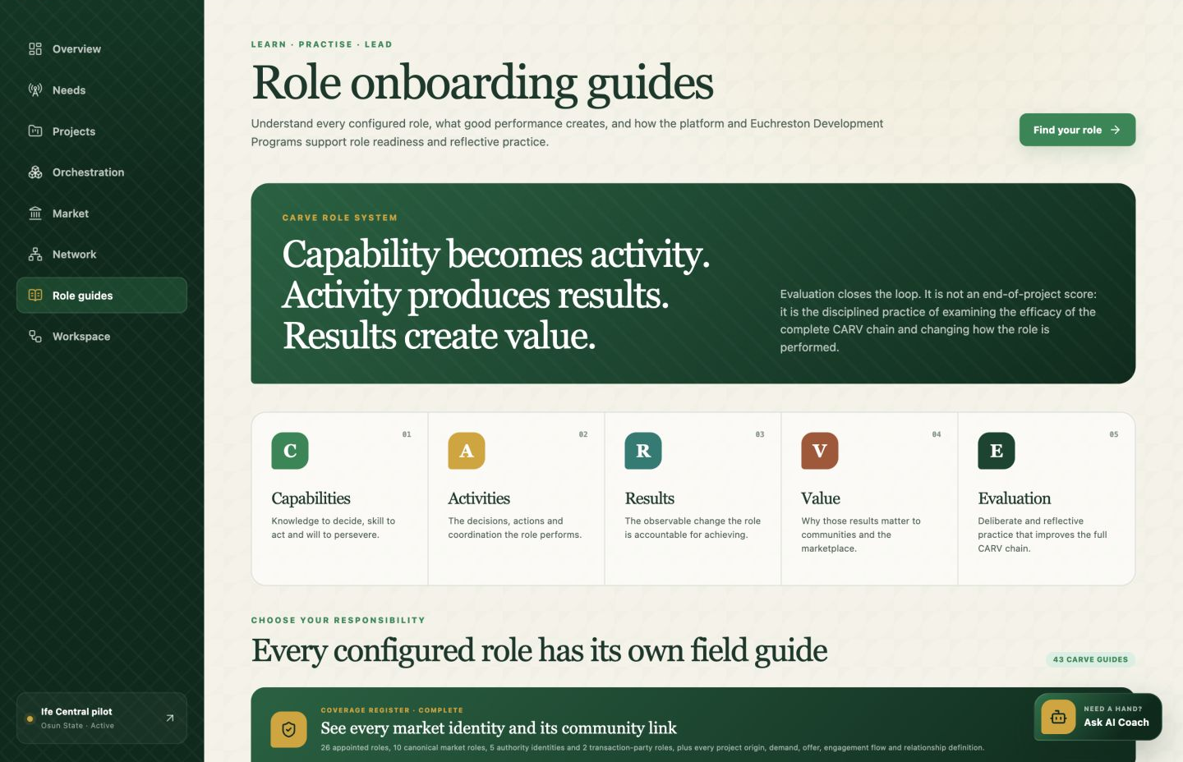
PEOPLE MAKE THE MECHANISM REAL
Every role knows the result, value, activity, capability and evidence expected.
R
Results
What must change
V
Value
Why the role matters
A
Activities
Decisions and actions
C
Capabilities
Knowledge · skill · will
E
Evaluation
Reflect and improve
Community, market, provider, sponsor and assurance identities are covered—including where one person holds more than one identity.
COMMUNITY ACTIVATION + MARKET ORCHESTRATION
11
Notes:
Explain that role clarity and development support are operating controls, not documentation added after launch.
[Sources]
- Community Activation & Market Orchestration Platform, live application capture, 14 Aug 2026.
- "The Programme – Architecture Infographic", internal programme architecture supplied by Euchreston.
- "Executive Summary 1 – Roles and Development Proposition", internal programme documentation supplied by Euchreston.
- "Executive Summary 2 – Organization and Operational Proposition", internal programme documentation supplied by Euchreston.
[/Sources]

Slide 12
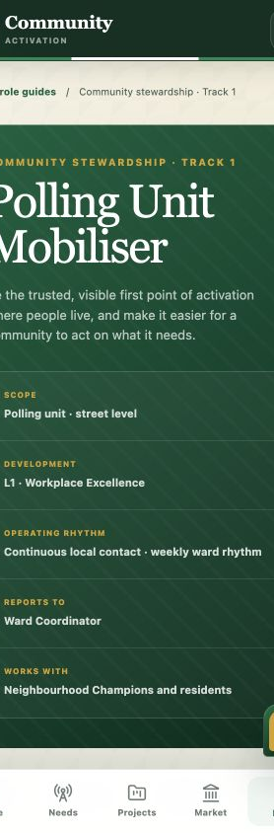
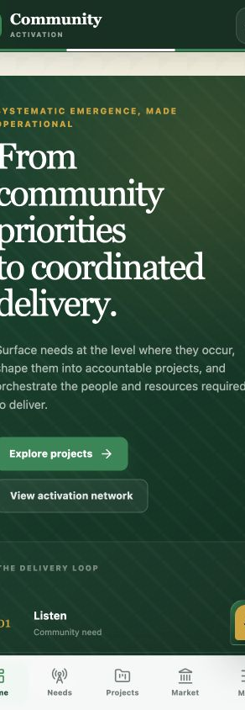
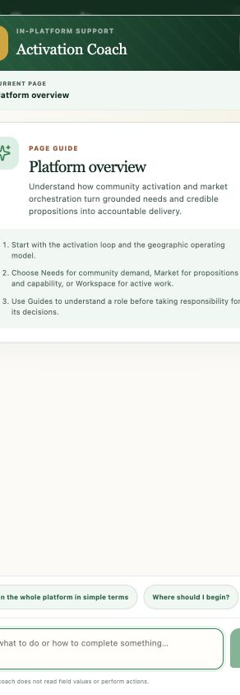
DESIGNED FOR THE FIELD
Mobile-first guidance makes the operating model usable in the field.
Responsive workspaces, role-specific guidance and an in-field AI coach reduce the distance between a policy and the next correct action.
PAGE-SPECIFIC
Ask what a field means or how to complete it.
ROLE-AWARE
The coach links guidance to the user’s role, current page and programme controls.
COMMUNITY ACTIVATION + MARKET ORCHESTRATION
12
Notes:
Show how role guidance and the AI coach make a sophisticated operating model usable on mobile.
[Sources]
- Community Activation & Market Orchestration Platform, live application capture, 14 Aug 2026.
- "The Programme – Architecture Infographic", internal programme architecture supplied by Euchreston.
- "Executive Summary 1 – Roles and Development Proposition", internal programme documentation supplied by Euchreston.
- "Executive Summary 2 – Organization and Operational Proposition", internal programme documentation supplied by Euchreston.
[/Sources]

Slide 13
WHERE STRATEGIC SUPPORT CREATES LEVERAGE
Back the operating infrastructure—not only the next visible project.
CSR and philanthropic partners can strengthen the capacity that many communities, entrepreneurs and projects will reuse.
PLATFORM
ACTIVATION
Shared infrastructure
Local operating cells
Identity, workflows, evidence, field access and national coordination.
Roles, onboarding, safeguarding and the rhythm that makes a geography active.
TRUST
MARKET
Independent assurance
Ecosystem depth
Verification, consent, dispute, remediation and accountable learning.
Credible entrepreneurs, providers, sponsors, institutions and appropriate capital.
COMMUNITY ACTIVATION + MARKET ORCHESTRATION
13
Notes:
Invite partners to support reusable operating capacity while preserving transparent routes into specific projects and opportunities.
[Sources]
- "The Programme – Architecture Infographic", internal programme architecture supplied by Euchreston.
- "Executive Summary 1 – Roles and Development Proposition", internal programme documentation supplied by Euchreston.
- "Executive Summary 2 – Organization and Operational Proposition", internal programme documentation supplied by Euchreston.
[/Sources]

Slide 14
A SHARED SYSTEM FOR LOCALLY LED ACTION
See the mechanism.
Then choose where to strengthen it.
LOCAL
+
MARKET
Explore the no-sign-in showcase, review the pilot operating manual and discuss a strategic partnership route.
community-activation-platform.vercel.app/showcase
COMMUNITY ACTIVATION + MARKET ORCHESTRATION
14
Notes:
Close by asking which layer the partner wants to strengthen: shared platform, activation capacity, trust infrastructure or market depth.
[Sources]
- "The Programme – Architecture Infographic", internal programme architecture supplied by Euchreston.
- "Executive Summary 1 – Roles and Development Proposition", internal programme documentation supplied by Euchreston.
- "Executive Summary 2 – Organization and Operational Proposition", internal programme documentation supplied by Euchreston.
[/Sources]

